Slide 1
The Ottawa Clinic
Non-Surgical Technology on the rise

Slide 2
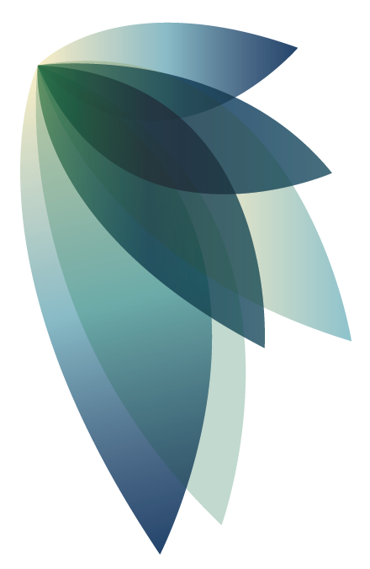
Non-surgical = minimal pain and fast results
Non-surgical body contouring techniques
Minimal discomfort with little to no downtime
Results are often seen six to eight weeks after treatment

Slide 3
What is CoolSculpting?
CoolSculpting® is a safe way to get rid of stubborn fat without surgery. The technology freezes fat cells and breaks them down for your body to expel naturally.
Click to watch!

Slide 4
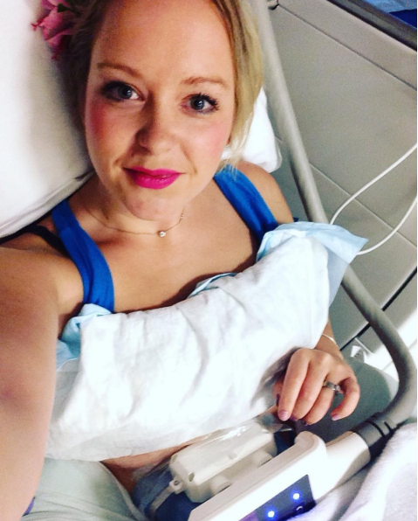
Achieve your body goals and feel good
“I can’t walk past a store window or a mirror these days without taking a glance at my reflection with a big smile on my face,” says Melissa, patient liaison at The Ottawa Clinic.
Click to read Melissa’s full story

Slide 5
Smaller area? Check our our CoolMini™
CoolMini™ uses CoolSculpting ® technology, but the size and shape is designed to fit comfortably around fatty areas that are resistant to diet and exercise.
Click to learn more!

Slide 6
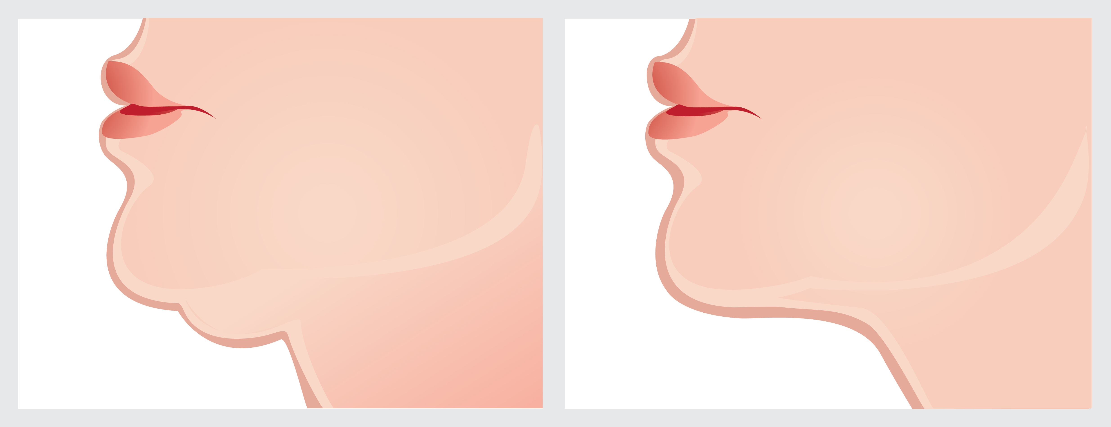
Target stubborn chin fat with BELKYRA™
BELKYRA™ breaks down the submental fat over six weeks, leaving a clean jaw line. Injections are made on the underside of the chin to target the fat cells.

Slide 7
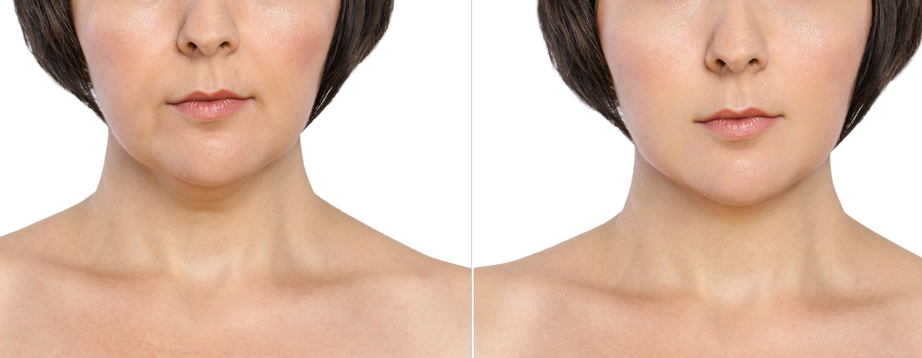
Achieve your body goals and feel good
“Most weight loss procedures target other areas of the body, like the stomach and thighs, and can cost double that of BELKYRA™. This injectable focuses on persistent submental fat,” explains Dr. Nodwell. “Many people no longer have to undergo surgical procedures like liposuction to add definition to their chins and neck profiles.”
Fun Fact: The Ottawa Clinic was among the first in Canada to be certified to offer BELKYRA™!
Click to find out more!

Slide 8
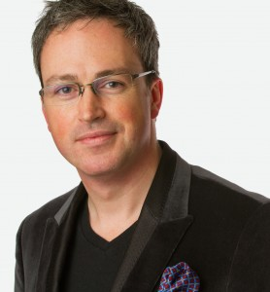
“Some people do not want the downtime of a surgical procedure, CoolSculpting ® and BELKYRA™ can be less invasive solutions…”
Dr. Nodwell

Slide 9
For more information on whether CoolSculpting® and BELKYRA™ are right for you, get in touch and book a consultation.

